Slide 1
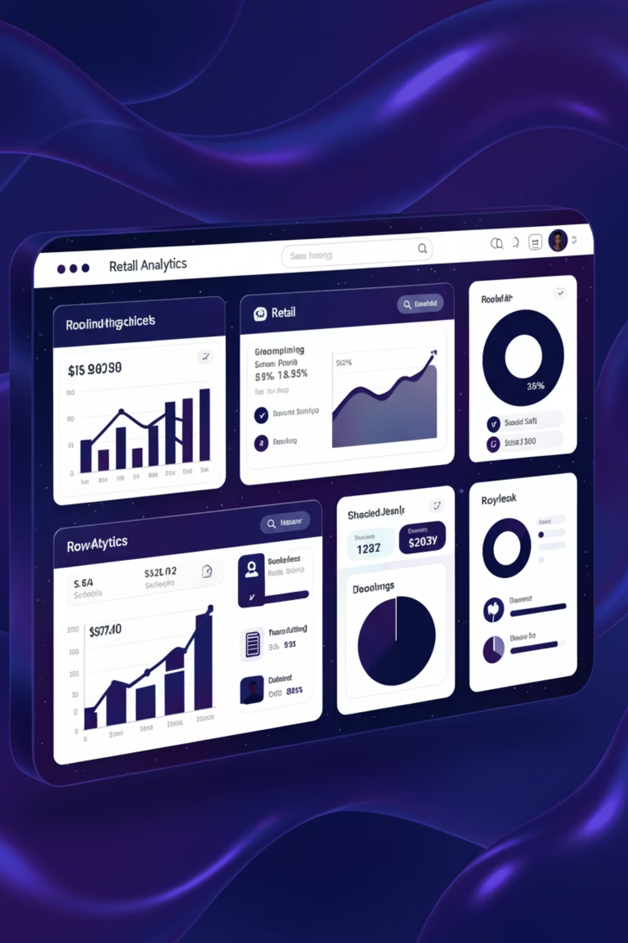
DATA ANALYTICS
Customer Shopping Behavior Analysis
Analyzing 3,900 customer transactions to uncover spending patterns, preferences, and strategic opportunities for business growth.

Slide 2
Dataset Overview
3,900
18
50
25
Total Purchases
Data Points
Locations
Products
Transactions analyzed across all categories
Comprehensive customer and purchase attributes
Geographic distribution of customers
Unique items across four categories
Customer Demographics
Shopping Behavior
Age, Gender, Location
Product Categories & Preferences
Subscription Status
Discount & Promo Usage
Purchase History
Review Ratings & Shipping

Slide 3


PYTHON
Data Preparation & Cleaning
01
Data Loading & Exploration
Imported dataset using pandas, analyzed structure with df.info() and summary statistics
02
Missing Data Handling
Imputed 37 missing Review Rating values using median rating per product category
03
Feature Engineering
Created age_group bins and purchase_frequency_days for deeper analysis
04
Database Integration
Connected to PostgreSQL and loaded cleaned data for SQL analysis

Slide 4

Key Dataset Statistics
Customer Profile
Purchase Behavior
Shopping Patterns
Average Age: 44 years
Avg Purchase: $59.76
Avg Previous Purchases: 25
Age Range: 18-70 years
Price Range: $20-$100
Top Category: Clothing (45%)
Gender Split: 68% Male, 32% Female
Avg Rating: 3.75/5.0
Discount Rate: 43% of orders

Slide 5
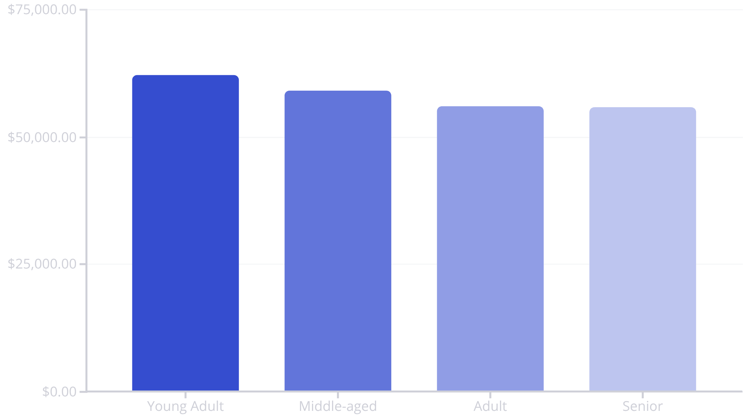
SQL ANALYSIS
Revenue Insights
Revenue by Gender
Subscription Impact
Male: $157,890 (68%)
Subscribers: 1,053 customers, $59.49 avg
Female: $75,191 (32%)
Non-subscribers: 2,847 customers, $59.87 avg
Male customers drive majority of revenue despite similar average spend
Similar spending patterns across subscription status
Young adults contribute highest revenue at $62,143, followed closely by middle-aged customers at $59,197.

Slide 6
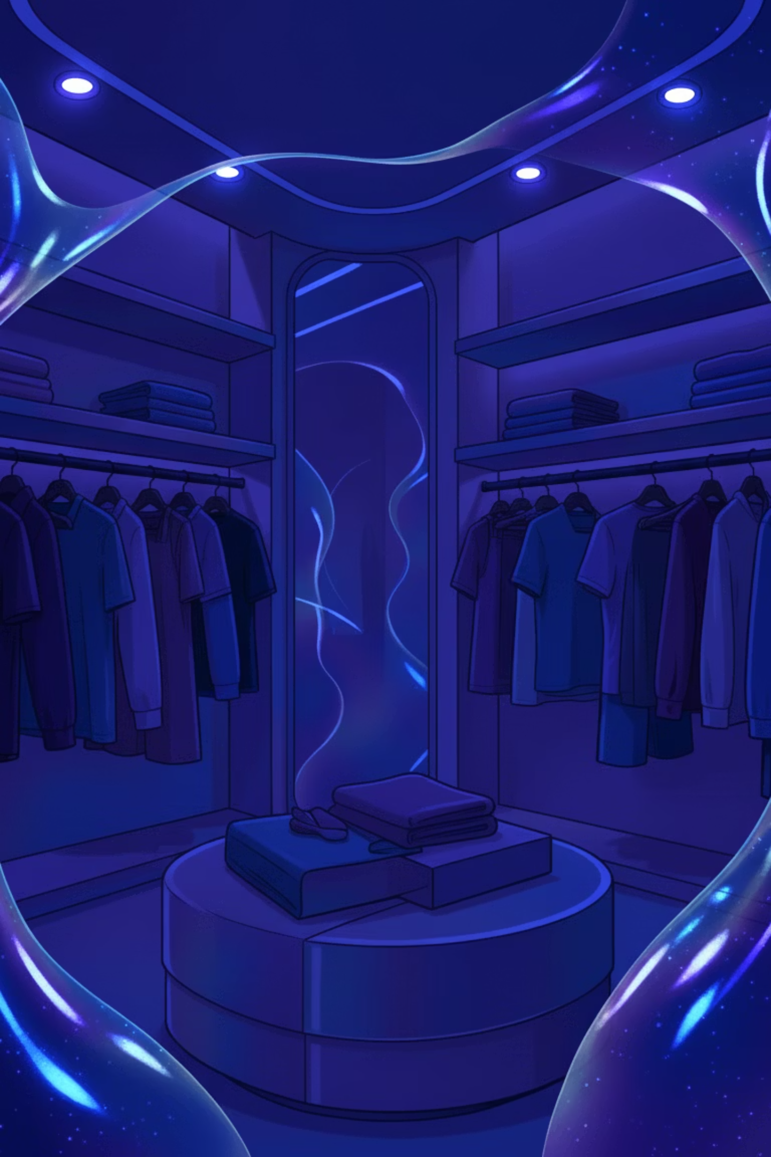
Product Performance Analysis
Top-Rated Products
Discount-Dependent Items
Gloves – 3.86 rating
Hat – 50% discount rate
Sandals – 3.84 rating
Sneakers – 49.66% discount rate
Boots – 3.82 rating
Hat – 3.80 rating
Coat – 49.07% discount rate
Skirt – 3.78 rating
Sweater – 48.17% discount rate
Pants – 47.37% discount rate
High-rated products show strong customer satisfaction, while certain items heavily rely on discounts to drive sales.

Slide 7




Customer Segmentation
Returning Customers
701 customers (18%)
Loyal Customers
Made multiple purchases, building loyalty
3,116 customers (80%)
Frequent purchasers with established buying patterns
New Customers
83 customers (2%)
First-time buyers with growth potential
Key Finding: 958 repeat buyers (>5 purchases) are subscribers, while 2,518 are not – significant opportunity for subscription conversion.

Slide 8

Shipping & Discount Patterns
Shipping Preferences
Smart Discount Users
Express: $60.48 avg purchase
839 customers used discounts but spent above average ($59.76)
Standard: $58.46 avg purchase
Express shipping users spend 3.5% more on average
Discounts drive sales without sacrificing purchase value
Category Distribution
Clothing: 1,737 purchases (45%)
Accessories: Strong secondary category
Footwear and Outerwear show growth opportunities

Slide 9
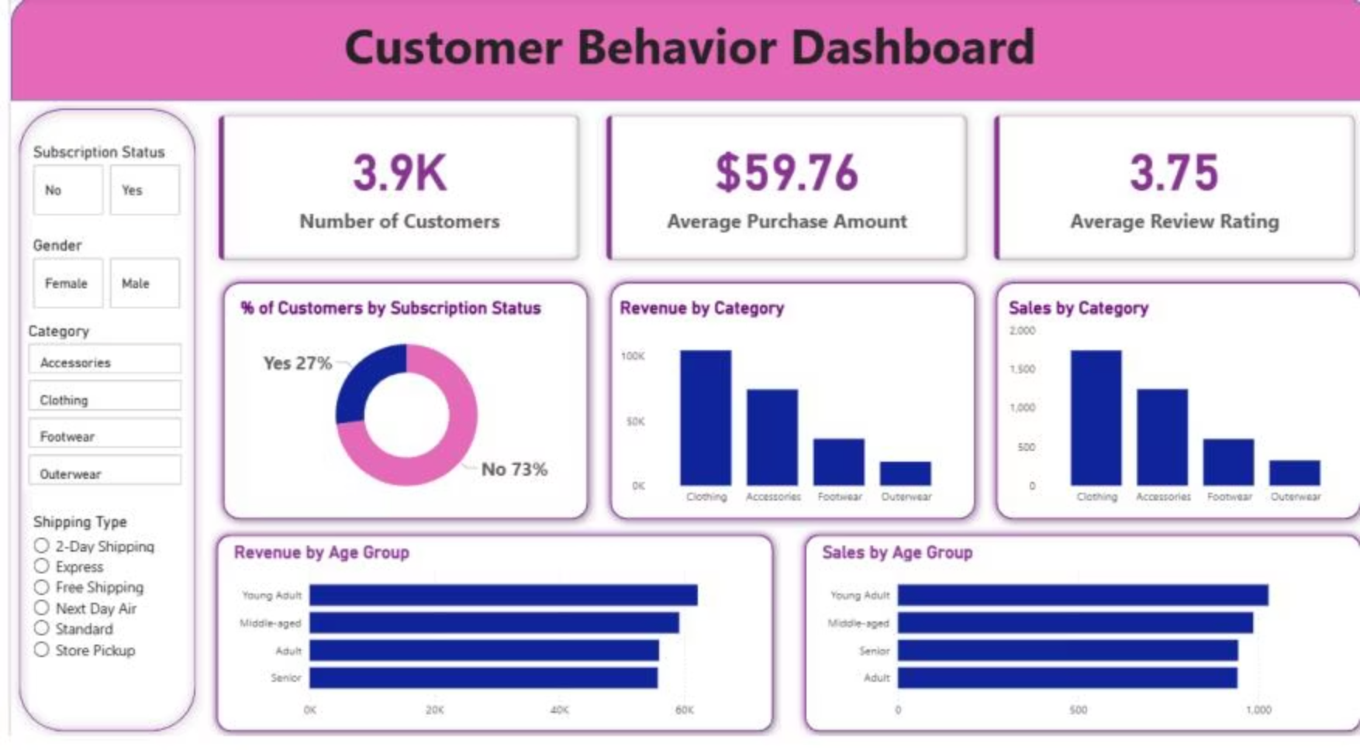

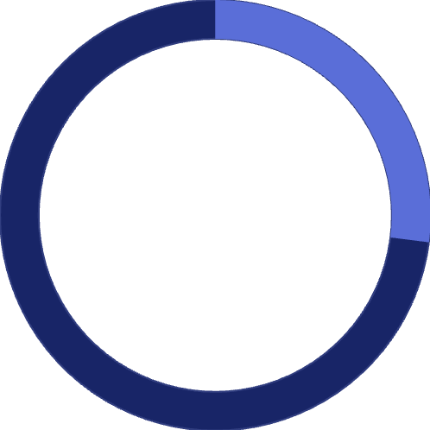
POWER BI
Interactive Dashboard Insights
73%
27%
Non-Subscribers
Active Subscribers
Majority of customer base without subscription benefits
Engaged customers with subscription status
Dashboard enables real-time filtering by subscription status, gender, category, and shipping type for dynamic business insights.

Slide 10





Strategic Recommendations
Boost Subscription Adoption
Promote exclusive benefits to convert the 73% non-subscriber base, especially targeting repeat buyers with >5 purchases
Launch Loyalty Programs
Reward repeat buyers to strengthen the loyal segment and move returning customers into higher engagement tiers
Optimize Discount Strategy
Balance promotional offers with margin control – focus discounts on high-dependency items while maintaining profitability
Targeted Marketing Campaigns
Focus on young adults and express-shipping users who drive highest revenue. Highlight top-rated products in promotional materials

